Slide 1
IT Operational Support Model TB982 – Optus Digital Agency (ODA)
Prepared by: Dante Lorredo
Date: 05th July 2012
V0.4

Slide 2
Optus Digital Agency
Objective: The Optus Digital Agency (ODA) project is an SMB initiative to provide a range of digital advertising solutions to Optus SMB customers. The goal and vision is to create a one-stop shop for SMB customers to purchase online advertising (presence and relevance) tools and services for the SMB to generate cost effective sales leads via the web.
Target RFS Dates:
Phase1 - SEO (Beta Launch): 9th May 2012 - achieved
Phase2 - SEO Downgrade/Upgrade (BRT launch) : 28th May 2012 – achieved
Commercial Launch SEO: 16th July 2012
Phase3 - SEM TBC
BRT: SEM TBC
Commercial Launch SEM: TBC

Slide 3
Key functions by Delivery Phase
Release1 – 9th May (BETA Launch) | Release2 – 28th^{th} May (BRT Launch) SEO Commercial Launch – 16th July May | Release3 – TBC SEM Commercial Launch – TBC
SODA Order - SEO | SEO/downgrade/upgrade Customer email notification | SODA Quote – SEO/SEM downgrade/upgrade
iProcess - SEO | email notification -support | iProcess Order - SEO/SEM downgrade/upgrade
TSA 1.1 & 1.2 – SEO site deployment) | TSA1.1 & 1.2 – SEO downgrade/upgrade site deployment | TSA 1.3 – SEO /SEM downgrade/upgrade site deployment
TSA – NCS interface (SaaS Connect) iProcess – NCS interface (Saas Connect) | TSA – NCS interface (SaaS Connect) iProcess – NCS interface (Saas Connect) | Soda Txn Log back up
Self Serve UI log-in –user creation and authentication, website update/redeployment | WAM Site Minder Configuration | iProcess Txn Log back up Business Works Process
Melbourne IT – IC ABN Registry - IC | Vertica Call Report Extract DCS - IDW Reporting files in to SRD Soda – IDW Data archiving
 | DB Replication/Back Ups without VIP HA on Customer Website | Front Jboss Load Balancing Database Replication (with VIP)
 | Performance Test Result
Proxy Interim Solution | Proxy Final Solution

Slide 4


Project ODA : Customer Support Flows and Systems
Desktop Support Client /
Web Form
QK Ticketing System
Google
Ticketing
NCS
Ticketing
OfficeApps
Support
F-Secure
Ticketing
QK Tech Support
Tech support
Melbourne IT
Partner Control
Customer
Phone
133343
Internet
Connectivity
IFMS
ODA
Optus IPS
Tier1 – Billing & General
Self Serve UI Log-in
SODA, iProcess
MAS Tier 2
Optus IT Servuice
Desk
O
D
A
Website Apps Support
TSA
Infrastructure, environment, systems outages, performance issues

Slide 5
Application Support Team
Below are the Optus support teams responsible for the ODA systems as per
PRAM agreement on 8th May 2012
System | Support Team | Portfolio/Support Manager
TSA Application | The Search Agency | Sanjib Biswas
TSA Host Environment - Mascot | Support Services, SSI | Chris Lynch
TSA Proxy/Load Balancer - Mascot | Support Services, SSI | Chris Lynch
iProcess - (includes MTS) | On Line Sales & CC Operations | Bindu Subhadramma
SODA Quote/Order (includes adapters) | IT Web Support | Sanjib Biswas
SODA - WAM/SiteMinder | IT Web Support | Sanjib Biswas
Proxy – Choc | IT Web Support | Sanjib Biswas
IDW - Report Files into SRD | IDW Service Operations | Amy Cheng
Vertica – Call Extract | Billing Service Operations | Ross Burke
Intermediate (DCS) – TSA Statistical Report Files | Billing Service Operations | Ross Burke
SOS/OPOM/MTS | On Line Sales & CC Operations | Bindu Subhadramma
SaaS Connect | NCS - Singapore | c/o Andrew Kim
Melbourne IT | Melbourne IT | c/o Andrew Kim

Slide 6
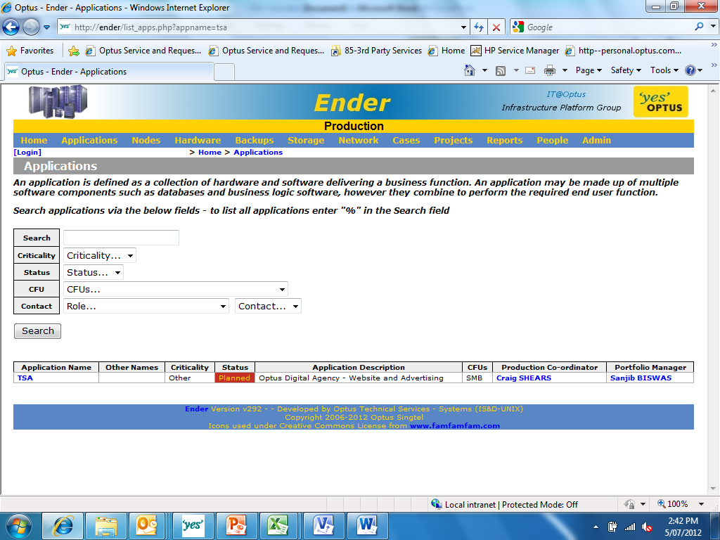
ODA Applications Set up in Ender
Ender is a catalogue/repository of all production applications that are supported by IT Service Operations. Soda, iProcess, and TSA are set up in Ender the with respective Application Support/Portfolio Manager assigned to it. For TSA, below is how it is set up in Ender.

Slide 7
Business Support Team
Resource | Role | Contact
Daniel Ringrose | ODM Portfolio Manager | 8082 7275 0416 074 646
Adam Russell | Business Project Manager | 8082 8290 0414 303 321
Jesse Snow | Business Owner | 8082 7762 0404 897 731
Andrew Kim | Product Manager | 8082 8021 0411 880 018
Mark Bayliss | Sponsor | 8462 6026 0423 608 424
MAS Tier 2 Support Team c/o Robert Hanimyan | ODA Support | 8082 9676 0419 431 304
Tier 1 Support Team c/o Robert Hanimyan | Billing & General Support | 8082 9676 0419 431 304
Steve Friend | Business Service Assurance | 8462 6026 0423 608 424

Slide 8
Customer Interaction Map

Slide 9
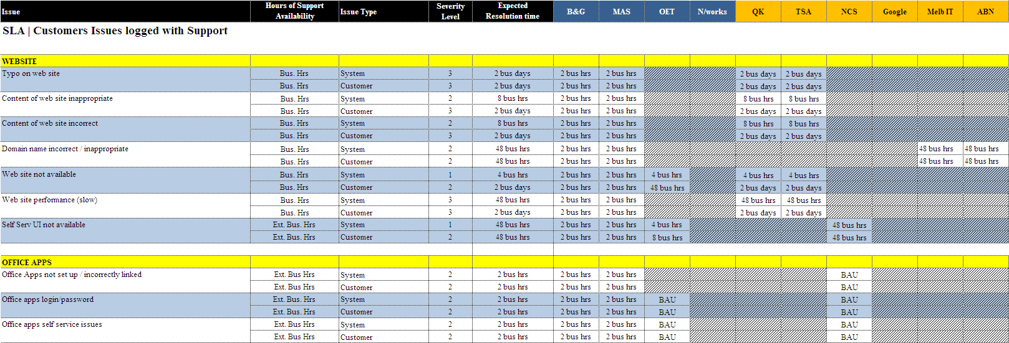
ODA - SLA

Slide 10
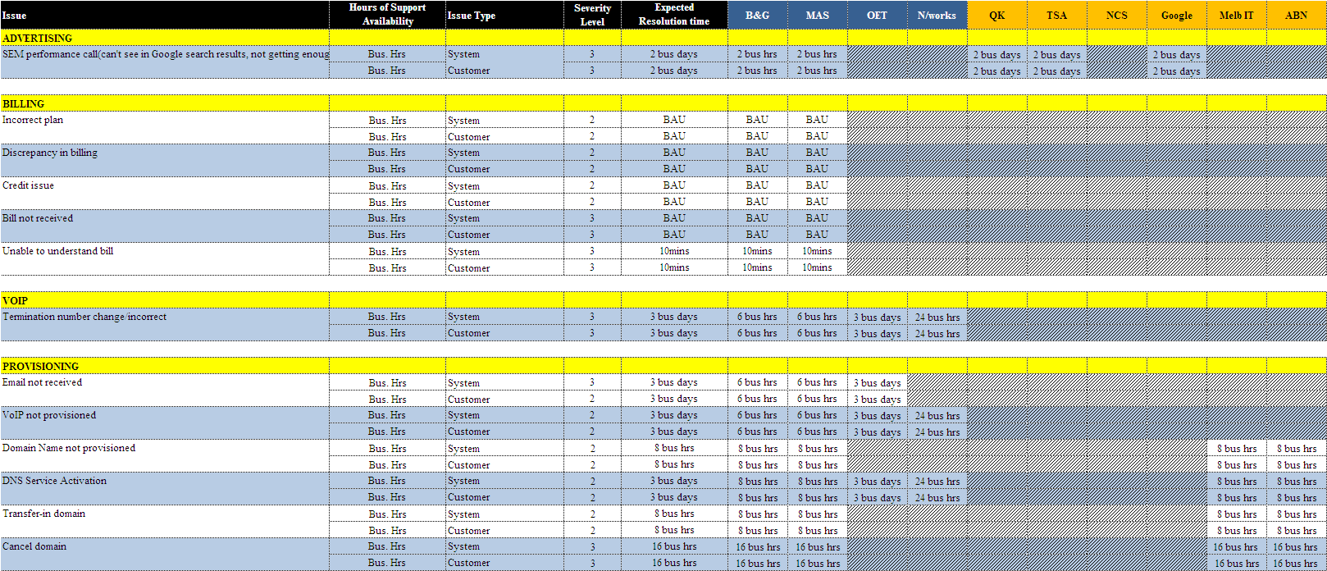
ODA - SLA

Slide 11
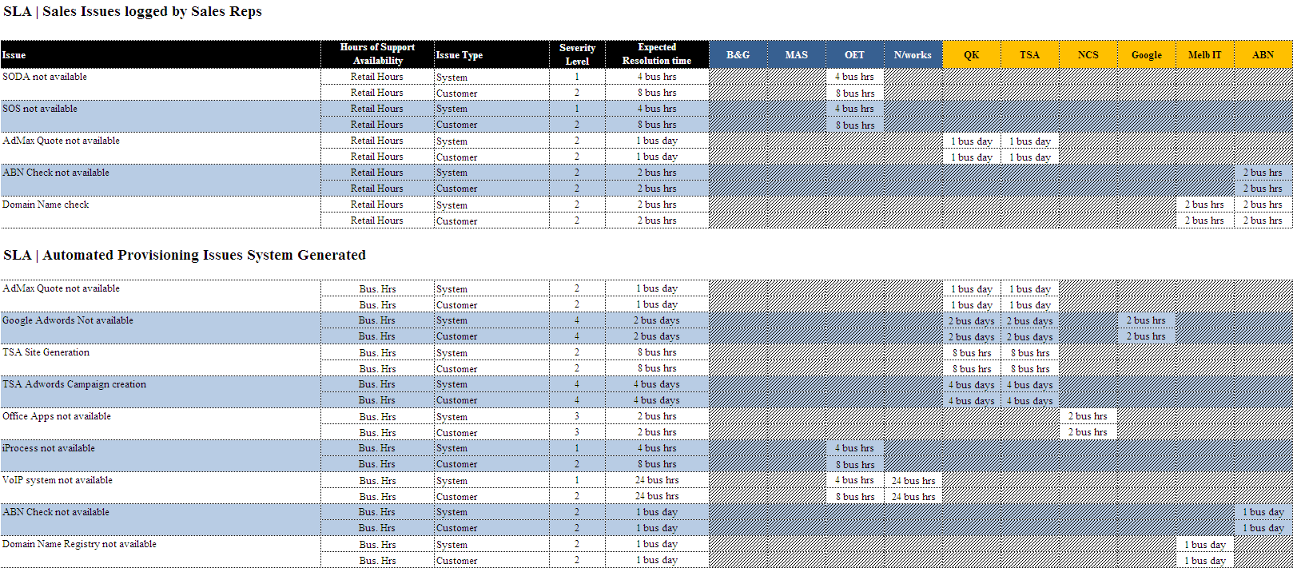
ODA - SLA

Slide 12

Project ODA : Key Txn Workflow and Systems (SEO)
Sales &Provisioning Team
1
Customer request quote externally
Customer request quote/order via CSR
CSR can retrieve customer quote
2
SODA Quote
External Facing Website
2
3
10
CSR provision order in SOS Arbor and
Order details send to OPOM & MTS
1
Vertica extract file
3
SOS
Arbor
4
CSR cut and paste order details from
SOS to SODA
4
ABN Registry
5
SODA passes the order to iProcess
SODA Quote/Order
Internal Facing Website
6
iProcess verifies SOS order details from
MTS
Melbourne IT
OPOM
7
iProcess sends deploy website request
to TSA
5
8
TSA Deploy Call back confirmation to SODA
iProcess
6
9
Customer log-in through SAS connect
To update website
MTS
8
Customer calls extrract edf rom Vertica
Sends to SODA and onto TSA to be
displayed in
Websitedashboard
7
10
TSA
11
11
Customer Statistical info for reporting sends via DCS to IDW
DCS
IDW
11
12
TSA Interface with Google
Customer SEO
Website
Manual Update
Google
New applications
BAU – No change
SaaS Connect
Reporting – IC update
9
Non Optus change
12
Notes:
12
12

Slide 13
Key Roles and Responsibilities (SOW2) – TSA
Responsible for their application install in all environments
Perform testing of their applications and will be delivered to Optus free of sev1’s and sev2’s defects
Manage the TSA Software integration requirements, customisation and successful implementation.
Work with Optus development teams to integrate TSA Software with ODA and NCS SaaS Connect.
Provide access to development versions of the Software, which may not provide full functionality
Manage changes to the Software to maintain conformity with the Specifications.
Provide release notes that indicate known defects and those fixed in the release or future releases
Maintain a log of version control for each environment
Assist Optus in troubleshooting with deployment of any release that fails to install
Provide technical documentation for API contracts
Customer Usage
Customer

Slide 14
Key Roles and Responsibilities (SOW2) – TSA Application - Optus
Hosting Platform
Service Management
Customer Usage
Optus will be providing application hosting for The Platform. As the hosting provider, Optus will:
Install Base OS
Provide Network connectivity
Provide VPN Connectivity for TSA to manage servers
Install Database Engine (MySQL)
Provide Load Balancing
Manage/Maintain Internal DNS
Configure database replication
Optus will provide base operating systems and database engines on all the Optus hosted systems.
Optus will be providing a managed service for the application Hosting environment. In this capacity, Optus will provide:
Backups of all critical data
System Monitoring
Hardware Maintenance
Capacity Updates as requested by TSA and authorized by Optus
System/Application performance reports
Management of database replication Optus will make reasonably
NB: for details, refer to the respective Operations Support Manual

Slide 15
Back Ups and Restore Responsibilities
System Components | Back Up | Restore | Comments
Hardware/OS | Optus | Optus | As per Conform
TSA Databases | Optus | Optus
TSA Applications | Optus | Optus | Only those that are included in the TSA hosting document
Soda Applications | Optus | Optus
Soda Databases | Optus | Optus
iProcess Applications | Optus | Optus
iProcess Databases | Optus | Optus
Customer Usage
Customer
NB:
Optus will provide back up and restore services for all TSA application components as per the requirements provided in the TSA Hosting Document prior to the last version. Any additional requirements will go through the normal Change Request Management Process
In case of restore, TSA may need to provide specific instructions, sequence of components to be restored based on specific scenarios
Any other components not included in the TSA Hosting component nor in the scope of conform will be TSA’s responsibility

Slide 16
Back Ups Scope
The following production servers and their corresponding directories will be in the scope of back as per the requirements outlined in the TSA Hosting Document. Likewise SIT and PPT servers will also be backed up
Customer Usage
TSA Host Size(GB) NFS Mount Name Presented to OS
odaadbibu01.syd 50 odaadbibu01.syd_backup \backup
odabidding01.syd 50 odabidding01.syd_backup \backup
odapixel01.syd 50 odapixel01.syd_backup \backup
odapixel02.syd 50 odapixel02.syd_backup \backup
odawww01.syd 50 odawww01.syd_backup \backup
odawww02.syd 50 odawww02.syd_backup \backup
odawww03.syd 50 odawww03.syd_backup \backup
odamonitor01.syd 20 odamonitor01.syd_backup \backup
odalvs01.syd 20 odalvs01.syd_backup \backup
odalvs02.syd 20 odalvs02.syd_backup \backup
odapxy01.syd 20 odapxy01.syd_backup \backup
odapxy02.syd 20 odapxy02.syd_backup \backup
odapxy03.syd 20 odapxy03.syd_backup \backup
Customer

Slide 17
TSA Monitoring Responsibilities
Scope
Server Accessibility (All Servers)
o Is the server responding to “Ping”
o Is the server responding to “SSH” requests
Disk Space (All Servers)
MySQL (all databases)
o Is the server responding to SQL commands
o monitor various stats (connection time, long running processes, etc.)
Web Service Availability (JBoss Servers)
o WSDL checks
o Sample heartbeat SOAP requests (where possible)
Log File Monitoring
o Parse logs for particular errors

Slide 18
Optus Monitoring Responsibilities - Infrastructure
Below are the default components monitored and their respective thresholds by HP Openview
Platform | Metric Type | Metric | Object | Interval | Warning Threshold | Critical Threshold | Targets
Linux (RHEL) | Failure/Error | Node/OM Agent Up | Node/OM Agent | 5 min | none | Node/OM Agent Down | All
Linux (RHEL) | Failure/Error | PM Agent Up | PM Agent | 1 hour | PM Agent Down | none | All
Linux (RHEL) | Failure/Error | Filesystem not mounted | All permanently mounted filesystems | 5 min | none | Filesystem not mounted | All
Linux (RHEL) | Failure/Error | CPU Count | CPU | 10 min | none | Number of CPUs is abnormal | All
Linux (RHEL) | Failure/Error | Memory Count | Memory | 10 min | none | Total physical memory size is abnormal | All
Linux (RHEL) | Failure/Error | Process Count | crond,sshd,ntpd,syslogd | 10 min | none | Less than 1 of listed processes running | All
Linux (RHEL) | Failure/Error | OS Event | Syslog | 10 min | Non-Critical failure/error | Critical failure/error | All
Linux (RHEL) | Capacity (Failure Limit) | Filesystem Freespace | All permanently mounted filesystems | 5 min | <15% freespace^{*1} | <10% freespace^{*1} | All
Linux (RHEL) | Capacity (Failure Limit) | Swap Utilisation | Swap | 5 min | >85% used | >90% used | All
Linux (RHEL) | Capacity (Performance Limit) | CPU Utilisation | CPU | 5 min | >90% for 30 continuous mins | none | L1 only^{*0}
Linux (RHEL) | Capacity (Performance Limit) | Memory Pageout Rate | Memory | 5 min | >1000 pages/sec for 30 continuous mins | none | L1 only^{*0}

Slide 19
Optus Monitoring Responsibilities – My SQL Data base
Check connect via hawkeye monitoring
Filesystem space monitoring via openview (In Prod only)
Check mysql files if they have grown more than 16GB by unix shell script
Check that slave is UP and running without any errors by unix shell script
Monitroing of errors appearing in MySQL log file
cron jobs setup for the maintenance, like purging of old backups; copying, archiving and purging of bin logs; rotation of various logs; housekeep etc. etc
backup is also run via the cron job, and we will work with Percona to see how we can monitor the backups
We will work with Percona to get the Monitoring Plugin for other monitoring using the Consulting hours received along with Percona Support.
email to send Warning and Alerts once the thresholds are met by the unix shell scripts placed in cron.

Slide 20
Change, Incident and Problem Management
Optus BAU process will be followed. Details are found in the following documents
Change Management Cheat Sheet
http://odmprdappw001.optus.com.au/livelink/livelink.exe/open/28308156
Incident Management Process:
http://odmprdappw001.optus.com.au/livelink/llisapi.dll/properties/215191
Incident Management Process Cheat Sheet:
http://odmprdappw001.optus.com.au/livelink/llisapi.dll/open/19034902 Problem Management Process Cheat Sheet:
http://odmprdappw001.optus.com.au/livelink/llisapi.dll/open/19035018

Slide 21
Production Change Management Process – Key Notes
TSA
Optus application Support - EWS
TSA is responsible for implementing TSA software changes in production
TSA to co-ordinate with EWS team and provide release notes and details of production changes
TSA upon RFC approval will deploy changes to production
TSA will perform post production sanity test
TSA will advise EWS upon successful completion of production implementation
(EWS c/o Sanjib Biswas )will create an RFC (SM7)
Will be responsible for Production outage notification
Will be provided copy of RFC to TSA for review
Will advise TSA once RFC has been approved
Will close RFC upon advise by TSA of successful production implementation
Will send out notification of outage completion
EWS in general will also liaise with other support team on behalf of TSA

Slide 22
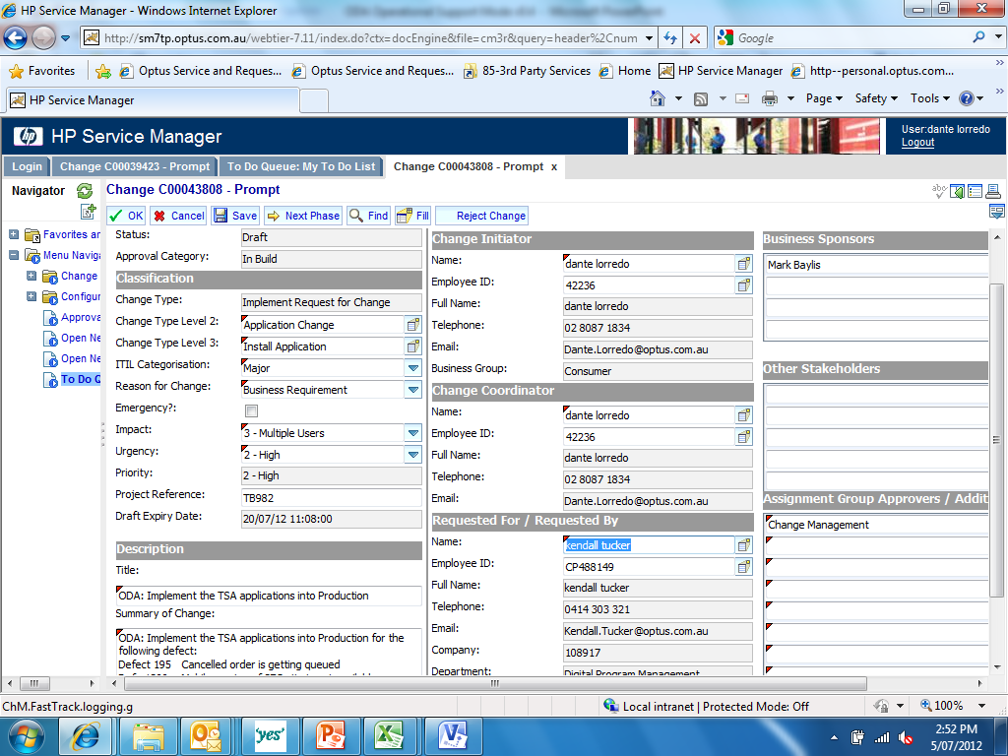
Sample RFC (SM7) FOR TSA Production Deployment

Slide 23
Production Incident Escalation and Management – Key Notes
TSA can contact IT Service Desks 24x7 by :
Phone: 02 – 9342 666
Email: ITServiceDesk@optus.com.au)
TSA support staff must be set up in Optus Directory reporting to Andrew Kim.
TSA may also contact the support group listed in the KBS form
KBS is also the mechanism for IT Service Desk to direct all production issues to the appropriate support group

Slide 24
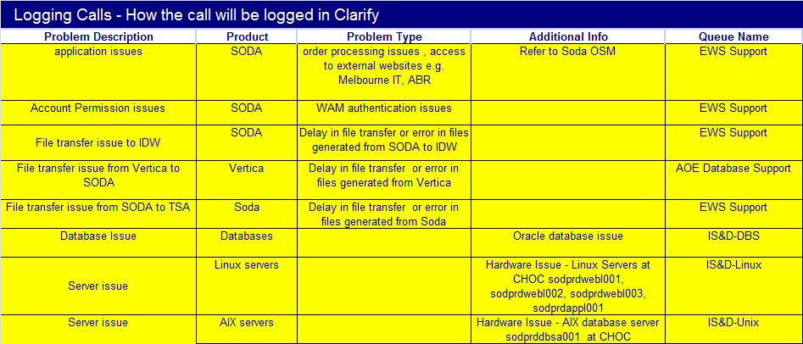
Knowledge Based System (KBS Form) - SODA
Escalations & Notifications for Majors and Planned Outages
Manual Escalation
Condition | Contact | Phone | Mobile | Email
SODA Application Failure | Sanjib Biswas | 02 8082 1640 | 0401 547 402 | sanjib.biswas@optus.com.au
Mandatory Notification - Distribution Lists/dropboxes to be notified of Majors and Outages
Contact | Means of Notification | Condition
EWS Support | email | SODA Applications Outage |  | EWS Support
TSA | email |  |  | Manasa.Denning@thesearchagency.com
iProcess | email |  |  | ODM FSSG
MAS Team | email |  |  | MyBizOnlineSupport@optus.com.au
IS&D-Linux | email | Infrastructure Outage |  | IS&D-Linux
IS&D-Unix | email | Infrastructure Outage |  | IS&D-Unix
IS&D-DBS | email | Database Outage |  | IS&D-DBS

Slide 25
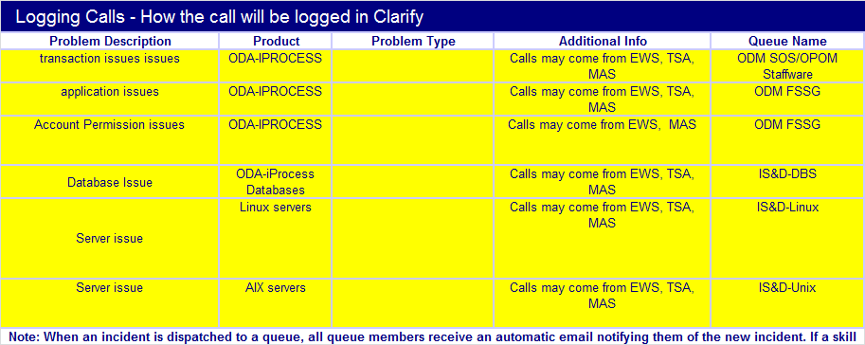
Knowledge Based System (KBS Form) - iProcess
Escalations & Notifications for Majors and Planned Outages
Manual Escalation
Condition | Contact | Phone | Mobile | Email
ODA-Iprocess Application Failure | Bindu Subhadramma | 02 8082 1145 | 0410 654 798 | Bindu.Subhadramma@optus.com.au
 | Andrew Kim | 02 8082 8081 | 0411 880 018 | andrew.kim@optus.com.au
Mandatory Notification - Distribution Lists/dropboxes to be notified of Majors and Outages
Contact | Means of Notification | Condition
ODM FSSG | email | iProcess Outage
ODM SOS/OPOM Staffware | email | ODA-IPROCESS pplication Outage
IS&D-Linux | email | Infrastructure Outage
IS&D-Unix | email | Infrastructure Outage
IS&D-DBS | email | Database Outage
TSA | email | all outages |  | Manasa.Denning@thesearchagency.com
MAS Support | email | all outages |  | MyBizOnlineSupport@optus.com

Slide 26
Knowledge Based System (KBS Form) - TSA
Escalations & Notifications for Majors and Planned Outages
Manual Escalation
Condition | Contact | Phone | Mobile | Email
TSA Application Failure (environment, network and Database related) | Sanjib Biswas | 02 8082 1640 | 0401 547 402 | sanjib.biswas@optus.com.au
TSA Application Failure (Customer Websites related) | TSA | 02 8875 7973 | 0433 357 943 | Manasa.Denning@thesearchagency.com
 | Mas support team |  |  | MyBizOnlineSupport@optus.com.au
 | Andrew Kim | 02 8082 8081 | 0411 880 018 | andrew.kim@optus.com.au
Mandatory Notification - Distribution Lists/dropboxes to be notified of Majors and Outages
Contact | Means of Notification | Condition
EWS Support | email | SODA, iProcess,TSA Applications , Infrastructure, Database Outage
MAS Support | email | SODA, iProcess,TSA Applications , Infrastructure, Database Outage
IS&D-Linux | email | Infrastructure Outage
IS&D-Unix | email | Infrastructure Outage
IS&D-DBS | email | Database Outage
TSA Support | email | SODA, iProcess,TSA Applications , Infrastructure, Database Outage

Slide 27
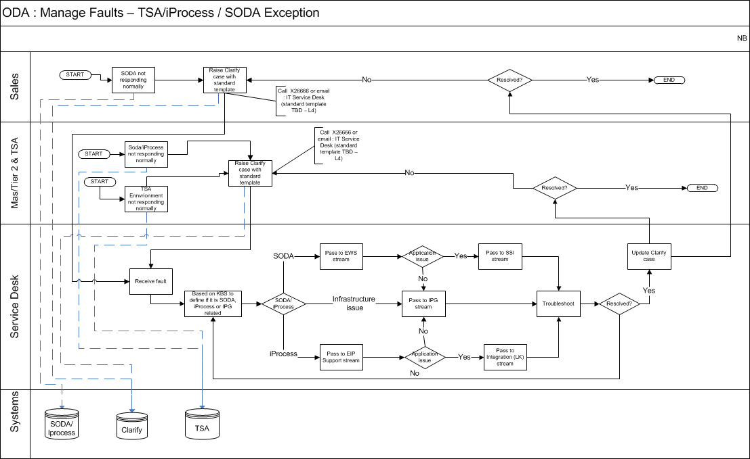
Problem Incident Escalation Process
Application Escalation Process

Slide 28
ODA Context Diagram (Next Pages)

Slide 29


SODA Quote Interface (Out of scope)
Customer Usage
TSA Front Jboss
https://myoptus.com.au/quote
Choc
Rever s
e
Proxy
WAM Site Minder
https 8443
www.obtusbusiness.com.au
TCP 80
SODA Quote
customer
Web browser
SODA & iProcess Database
TCP 1831
Email notification
SMTP Server

Slide 30
SODA Quote/ Order - SEO
TSA Back Jboss
TSA Front Jboss
Customer Usage
https://myoptus.com.au/quote
WAM Site Minder
Soap Adapter
iProcess Adapter
iProcess
SODA /Order
Customer
SODA Proxy Adapter
Forward Proxy
SMTP Server
Melbourne IT Adapter
SFTP
Melbourne IT
ABN Registry
Email notification
SODA Database
Vertica Call usage extract
IDW
Zeus Staging
Server
PT Scope

Slide 31





Public Customer Interface to the Website
Public customer
TSA - Customer Websites
Customer Usage
Tel No: 999-8888
Optus Mascot Reverse proxy
Manual call redirection
to business preferred no
Customer
TSA Logs public customer hits on the website
External ip address1
TSA Pixel1
External ip address1
TSA Pixel2

Slide 32

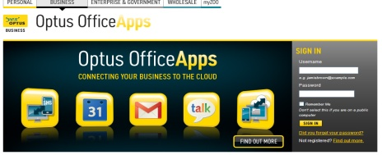
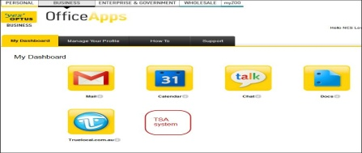


Self Serve UI and NCS SaaS Connect Integration
2
SaaS Connect
3
http://www.optusofficeapps.com.au/saas/usercenter/login.do
Customer Usage
ODA Mascot revere Proxy
1
http://www.mybizonline..com.au
Self Serve UI
4
Business Customer
Customer
Webservers
ODA Mascot forward Proxy
Front Jboss
5
6
Acct DB
Warehouse DB
1
User access Office Apps URL
2
User logs in through Office Apps
Pixel Servers
TSA Admax
Bid Budget
3
User directred to Office apps dashboard
And clicks on TSA/ODA Icon
TSA back jboss
4
User is redirected to TSA Self Serve UI
5
User requested changes sent to iProcess
iProcess
Soda
Soda
6
Customer Website update
Request for redeployment

Slide 33
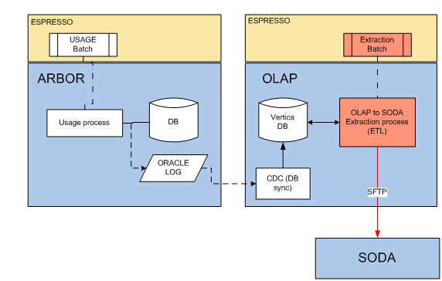

OLAP to SODA Interface
Customer Usage
Customer
Daily
TSA
iProcess
Customer Usage info (number of calls and relevant dates generated from the website are extracted from Vetica and send to SODA
SODA sends usage info to TSA via iProcess to be displayed onto the Customer Website dashboard .

